Slide 1
Bachelor Thesis I / Project Work II
WebRTC
Michael Stifter

Slide 2
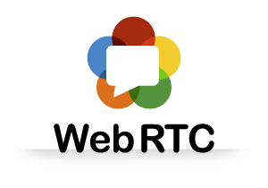
Notes:
WebRTC stands for Web Real-Time Communication.
It is a new technology and a W3C API definition currently under specification. This means it is on its way to become an HTML standard.
It enables you to communicate with others via voice calling, video chat or P2P file sharing – directly from the browser.
Now, you might be asking yourself: „That‘s great, but I already have Skype and a dozen other applications for that. Why would I need WebRTC?“, then you‘re absolutely right, Skype and many other applications do exactly that.
But – WebRTC does a few things in a significantly different way.

Slide 3


Notes:
If you want to communcate with someone over traditional chat applications, all the traffic goes over a web server.
With WebRTC, however, only the initiation of the conversation happens via a web server. Once the session has been established, all data goes directly from browser-to-browser. This is called peer-to-peer. The browser uses the camera and microphone from the device.

Slide 4


Notes:
Advantages:
It‘s free
No external plugins needed – platform and device independence
WebRTC enforces the use of encryption for both media and signalling (standard AES encryption)
Data flows directly between users, no servers involved
For developers: Standardized APIs – no special knowledge about network connections, media streams necessary. A bit of Javascript knowledge will be helpful, though ;-)
Disadvantages:
Still in development: Browser prefixes, APIs might change
As data is not processed by a server, clients have to store chat messages locally if needed
STUN and TURN servers are necessary if there‘s NAT involved
Only really easy if there‘s two users involved – from then on it gets difficult
Browser compatiblity

Slide 5
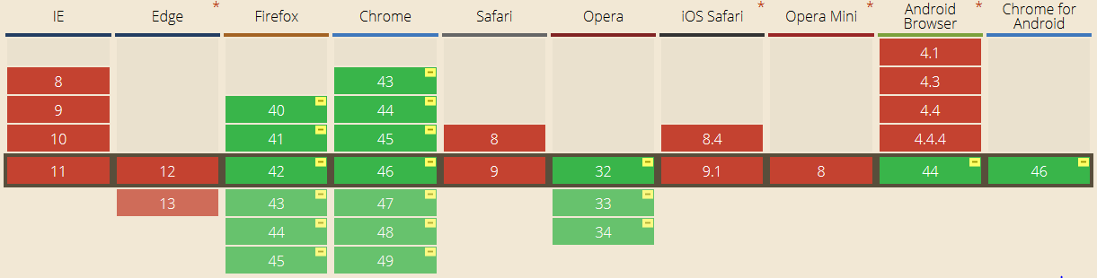
WebRTC readiness
as of November 2015
Notes:
Google Chrome, Mozilla Firefox and Opera
Microsoft and Apple are currently not interested in WebRTC. Bad news for Mac users!

Slide 6
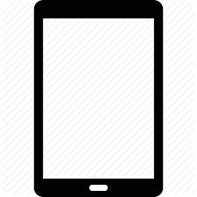

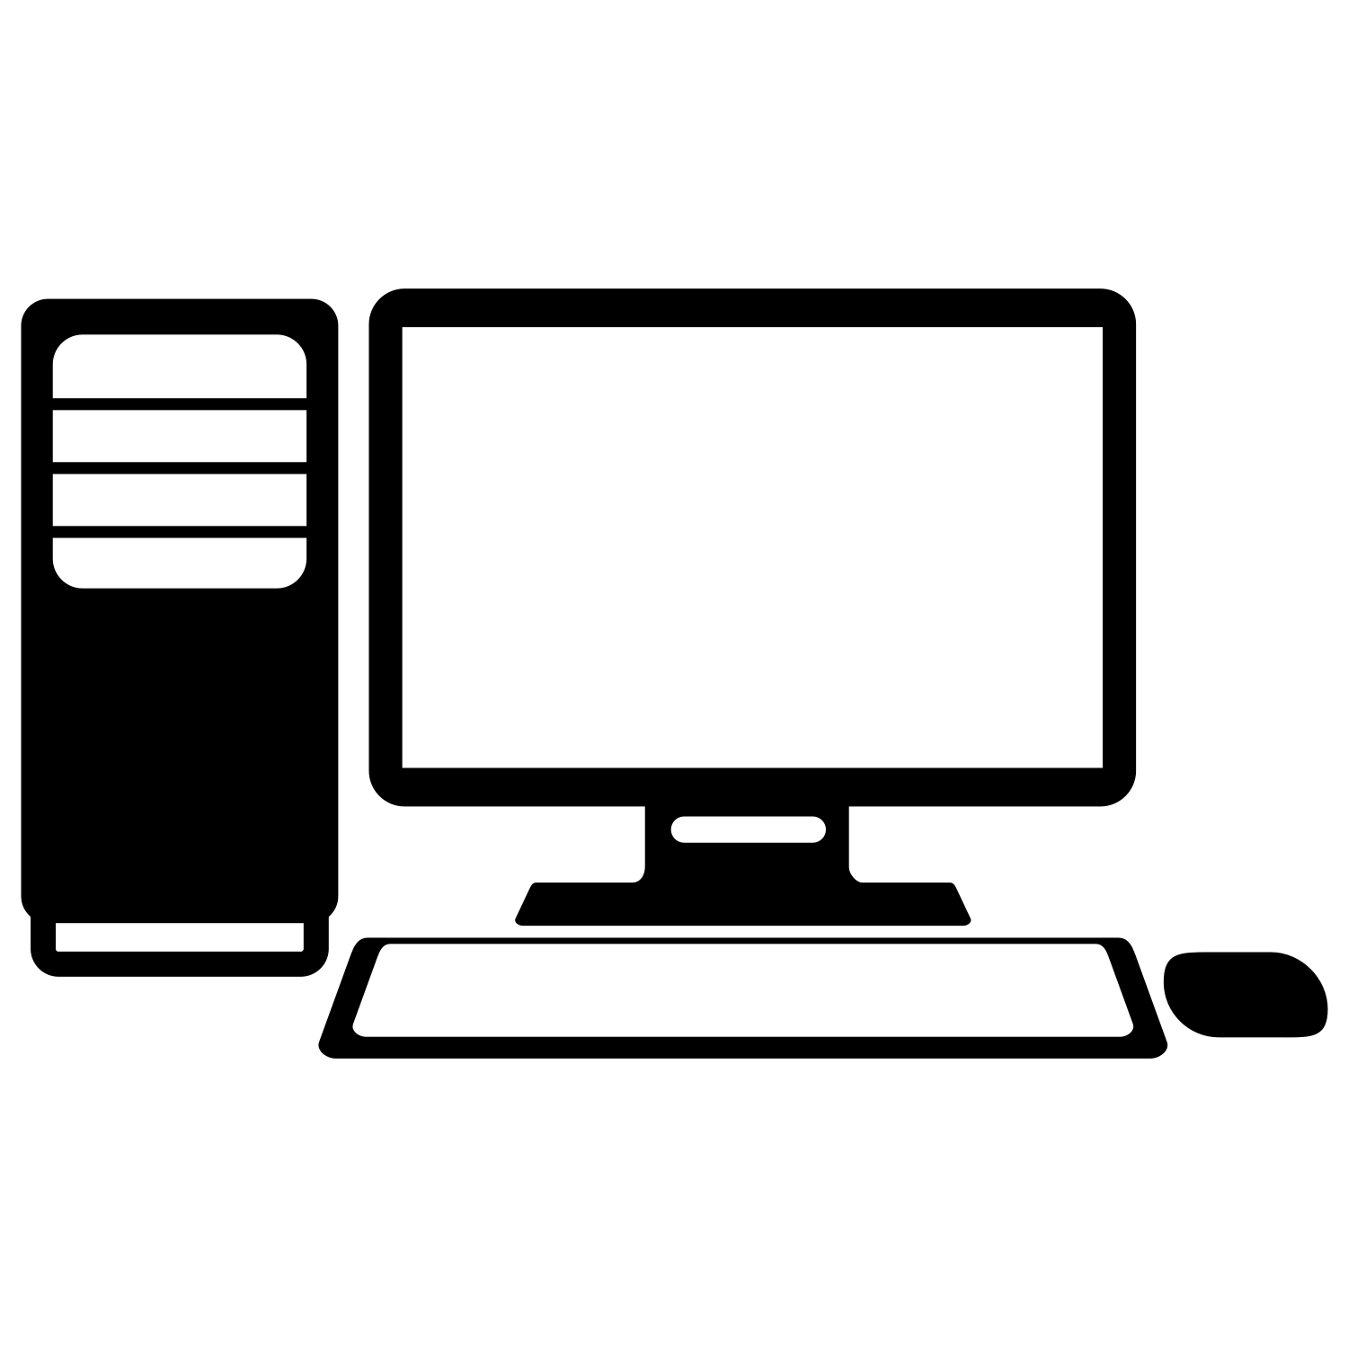
Remote support application
Notes:
Geometric figures for guidance
Text chat messages
Switch between modes (support mode, freeze frame)

Slide 7
Why?
Notes:
These kinds of remote support applications are a big part of „Industrie 4.0“, one of the biggest industry trends for a few years now. Really interesting and fast-emerging topic.
Advantages:
Experts can consult without being physically there
Malfunctions can be repaired quicker, by on-site personnel. It is not necessary for an expert to visit the site personally.
Similar applications cost a lot of money.
Using a proprietary video chat application might not be an option for companies. Especially if they are sensitive about their data, WebRTC might be something that they will be really interested in. Especially the advantages of WebRTC, like mandatory encryption of data and the removal of a third-party server in the communication process, solve a lot of the security concerns that companies might have.
There are a lot of loose code snippets for building a WebRTC demo from a few years ago, when WebRTC was introduced, including propositions on how to integrate a management server. However, there‘s a lack of a fully integrated open source solution with the current WebRTC specifications. Aditionally, most of the demos use additional libraries, like socket.io. In this application, all of the server functionality is self-developed and open source, thus fully configurable and extendable.
It‘s a very interesting and fast-emerging technology:
Just four years ago it was announced for the first time by Google
For a little over two years, Chrome and Firefox can work together
It brings lots of advantages for business and customers: Companies can communicate with their customers directly through the web page, thus eliminating the obstacle of setting up a personal appointment
Examples of existing WebRTC range of use and applications:
All kinds of domestic consultation (furniture, painting)
„Be My Eyes“ – volunteers can read nutrition/medicine labels for blind/visually impaired people

Slide 8
Goals
Notes:
Prototype
Simple application, easily extendable
Open Source
Lightweight management server – everything is self-developed and can be extended
Automatic user discovery (no authentication for now)
Possibility to call one other user (at a time)
Video, audio and text chat
Possibility to share the screen with the other user. Both users can make remarks in form of simple geometric shapes like circles, rectangles or lines that both users can see.

Slide 9
Approach
Notes:
Development of management server (Node.js)
Implementation of WebRTC functionality on client side
Responsive design for mobile devices (smartphones, tablets)
Determination of audio/video quality behaviour under limited network (WiFi) reachability
Evaluation: Working prototype like described before, meaningful investigation about WebRTC media quality behaviour under different levels of network reachability

Slide 10
Thanks for your attention!

